Slide 1
Prepare for Node.js+MySQL Demos
https://github.com/udaparts/socketpro
Copy libraries to a system directory
https://www.codeproject.com/Articles/1207129/Brief-Introduction-of-a-Continuous-SQL-stream-Se (smysql.dll/libsmysql.so + INSTALL PLUGIN UDAParts_SQL_Streaming SONAME ‘libsmysql.so’)
njadapter.node + nja.js (../socketpro/bin/js)
Samples at (../socketpro/src/njadapter)
Performance study samples (../socketpro/src/njadapter/perf_study)
all_servers (../socketpro/tutorials/(csharp|java|cpluplus)/all_servers
Help ???

Slide 2
Brief Introduction of SocketPro Asynchronous Communication Framework for WAN
Continuous Request Sending and Processing for the Highest Network Efficiency and Throughput
Yuancai (Charlie) Ye

Slide 3
Contents
Request Streaming Communication Pattern
SocketPro Architecture and Components
SocketPro Key Features
Node.js Demos
Client/server
Publish/subscribe
Persistent message queue
SQL-streaming
Master-slave with real-time updateable cache
File streaming
Analysis on nja.js + njadapter.node

Slide 4
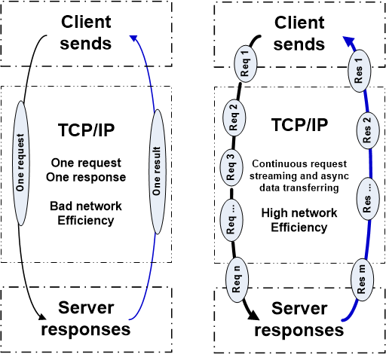
Two Basic Communication Patterns

Slide 5
SocketPro Communication Architecture and Components
Client Core
cross-platform
native code
Server Core
cross-platform
native code
Request batching and streaming, asynchrony, secure, parallel communication on TCP/IP
C++
Adapter
.Net
Adapter
Java
Adapter
Python
Adapter
JavaScript
Adapter
PHP
Adapter
Node.js
Adapter
C++
Adapter
.Net
Adapter
Python
Adapter
Java
Adapter
User Client Code
User Server Code

Slide 6
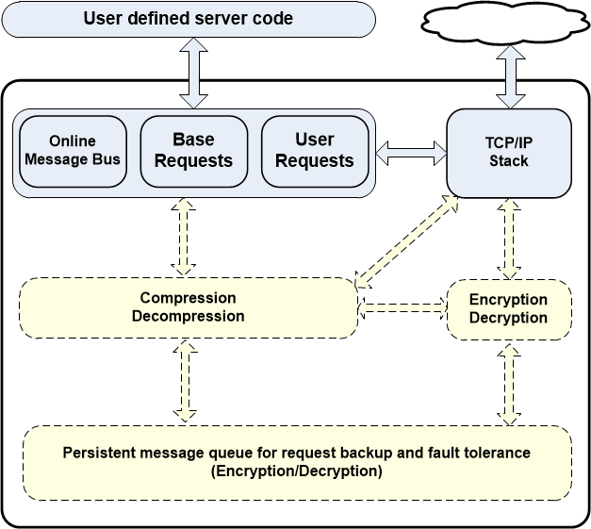
Client Core Features

Slide 7
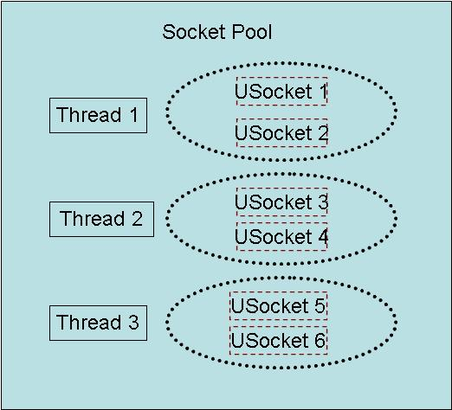
Client Socket Pool
A socket pool has three worker threads and each of these threads hosts two non-blocking sockets with fault tolerance for the best parallelism

Slide 8
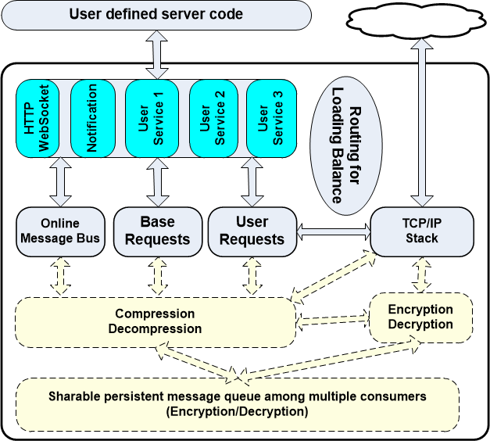
Server Core Features

Slide 9
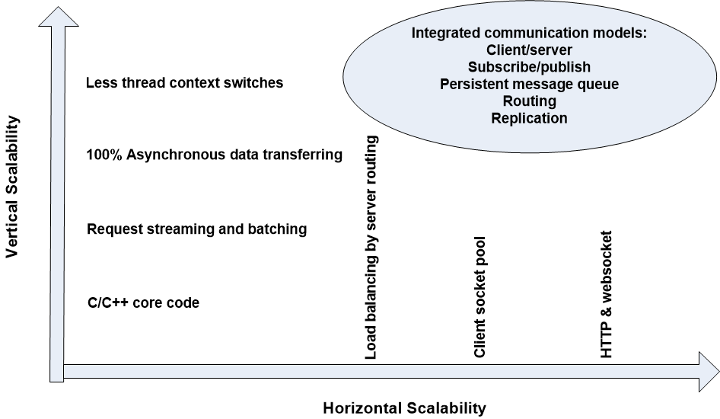
SocketPro Scalabilities

Slide 10
SocketPro Adapters for More Developers
C++ adapters – a few header and cpp files
One .NET adapter
Java adapter
Python adapter
Node.js adapter
One JavaScript adapter for browsers
PHP adapter in the future

Slide 11
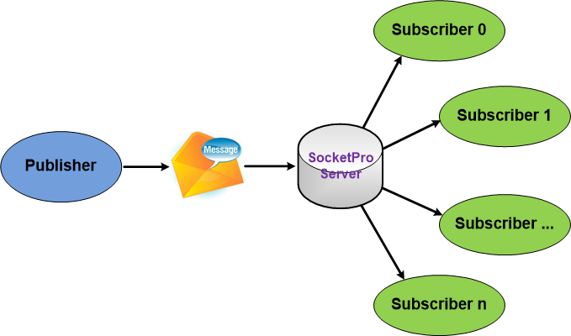
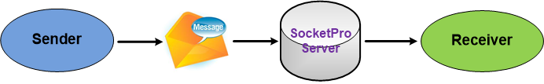
SocketPro Subscribe/Publish (Internet chat or online messaging)

Slide 12
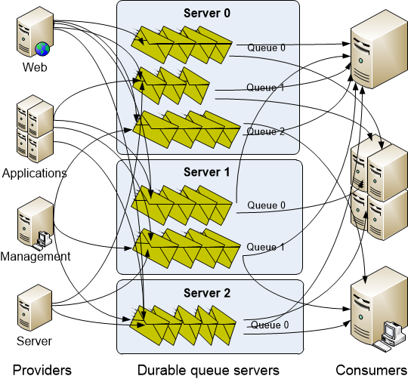
SocketPro Persistent Message Queue
Advantages of SocketPro over Kafka:
Manual transaction
Queue sharable among multiple consumers
Real-time message availability event (low latency)
No configuration settings
Faster than Kafka in message writing
Select a portion of requests to be queued persistently
No message loss as messages can be backed up at provider side

Slide 13
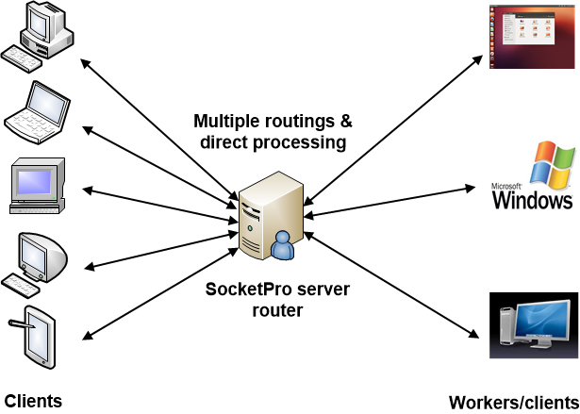
SocketPro Server Request Routing for Loading Balance with Fault Tolerance

Slide 14
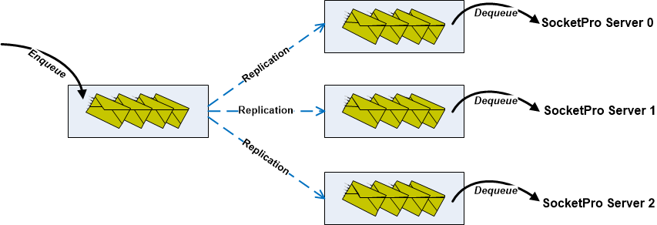
SocketPro Replication with ACID (Atomicity, Consistency, Isolation, Durability)

Slide 15
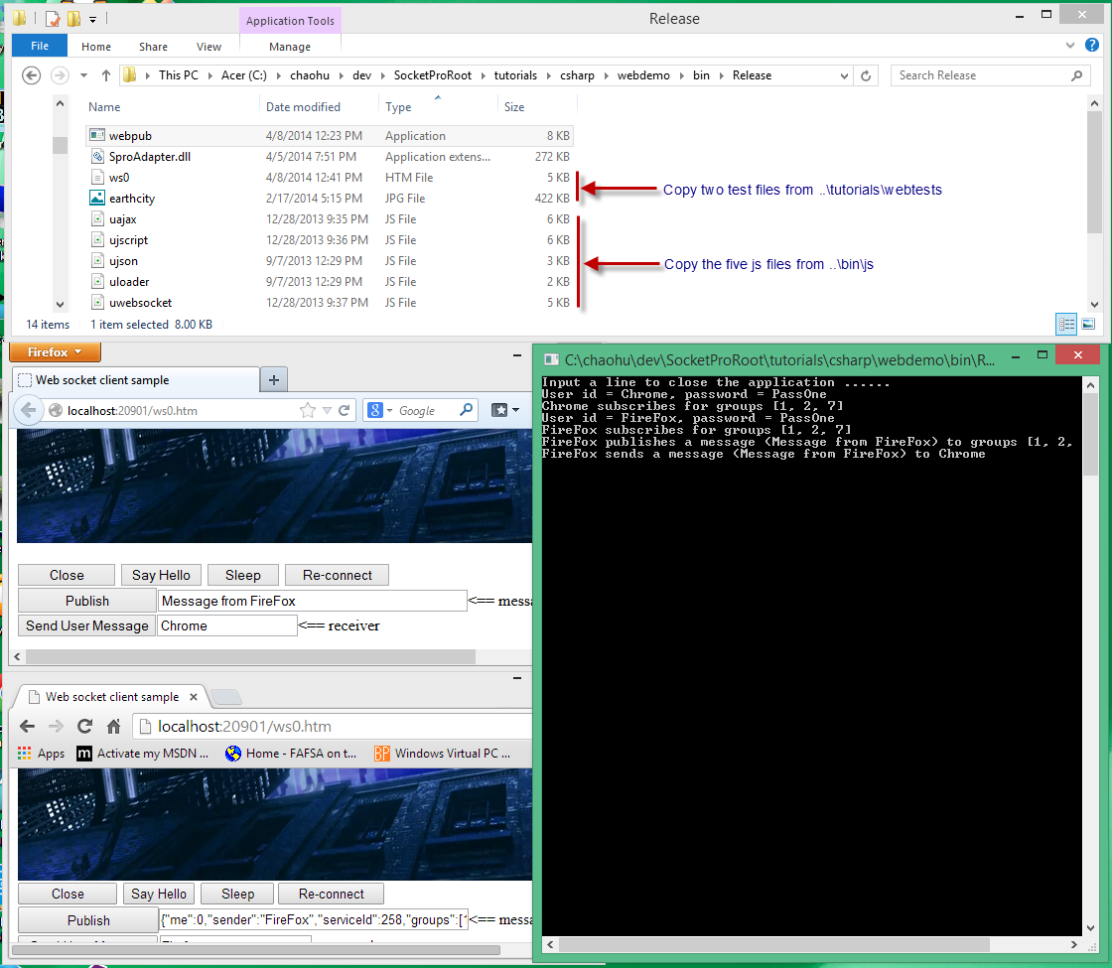
SocketPro HTTP/WebSocket

Slide 16
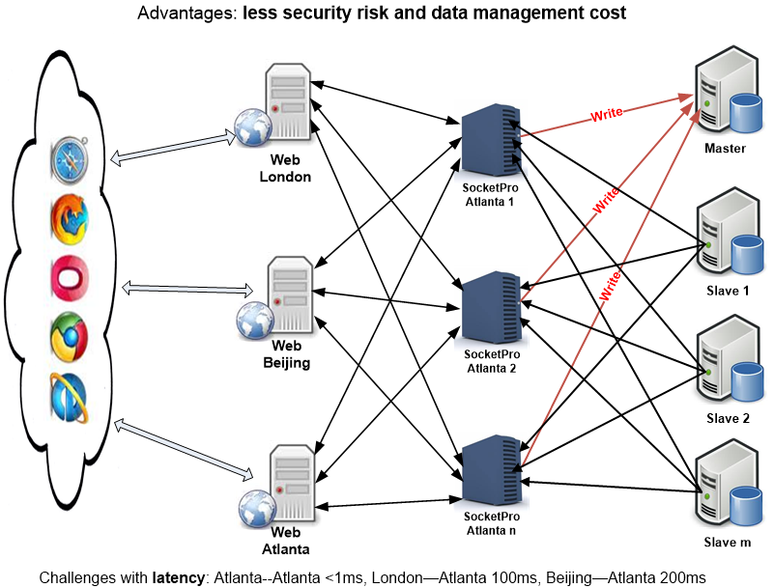
Global Web Systems by SocketPro

Slide 17
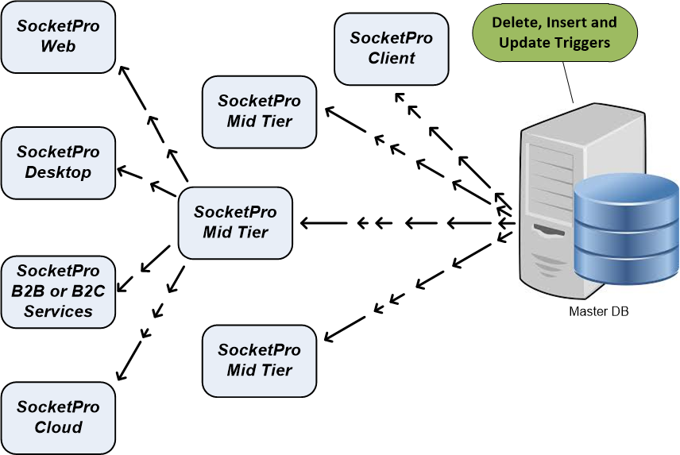
Real-time Updateable Cache

Slide 18
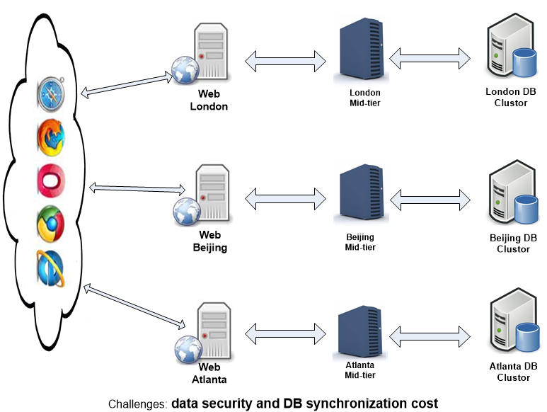
Global Web Systems by Common Approach

Slide 19
Simplification of design and architecture
(Async/await, integrated computation modes, freedom, flexibility and rich features)
Great for tough tasks
(Great UI response, cache, lots of items, unstable/slow WAN, threading, and stability)
Great integration
Unified but simple interfaces for different dev languages and Oss
Excellent with performance and scalability
+ Great interoperation among different environments
Simple but fast development

Slide 20
Demo for Client Server Pattern

Slide 21
Demo for Publish/Subscribe

Slide 22
Demo for Persistent Message Queue

Slide 23
Demo for SQL-streaming
SQLite + cache
MySQL/Mariadb + Cache
MS SQL Server + Cache
ODBC for Any Databases
Postgresql + Cache in the Future
DB2 + Cache in the Future
Oracle + Cache in the Future

Slide 24
SQL-Streaming Performance Study

Slide 25
Demo For Master/Slave + Cache

Slide 26
Demo For File Streaming

Slide 27
Analysis of (nja.js + njadapter.node)

Slide 28
Questions ?

